Slide 1



DATA FUSION AND MACHINE LEARNING I:
^{Bias x variance tradeoff}
^{K-NN, Random Forest, SVM}
DÉBORA CORRÊA AND AYHAM ZAITOUNY
^{23 OCT 2018}

Slide 2
^{THE BIAS VS VARIANCE TRADEOFF}
Underfitting
Overfitting

Slide 3
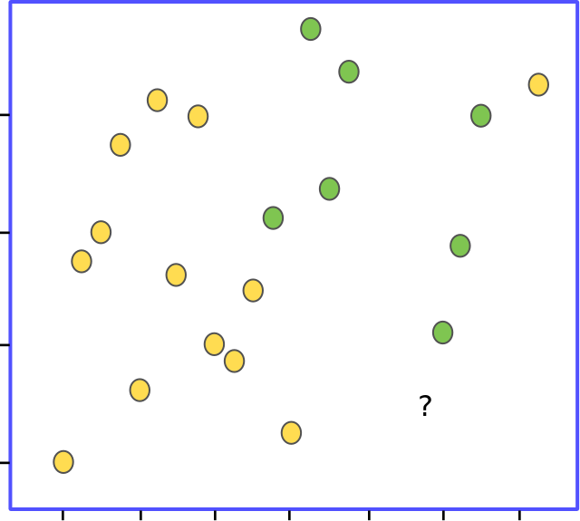
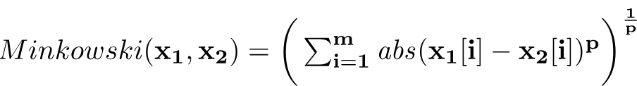
^{K-NEAREST NEIGHBORS (K-NN)}
Used for:
Classification and regression.
Instance-based learning (a model is not explicitly learned):
Based on measures of similarity: a distance metric defines the distance between the instances in a feature space.
Usually based on the Minkowski distance between two data instances x₁ and x₂ :
The parameter p defines the behaviour of the metric. If p = 1 we have the Manhattan distance, if p = 2 we have the Euclidean distance.

Slide 4
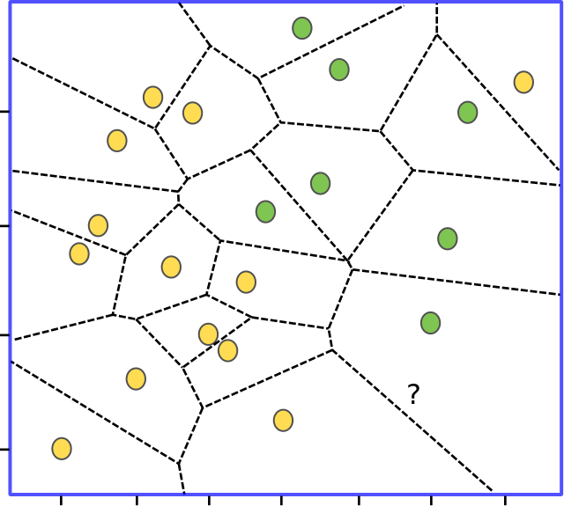
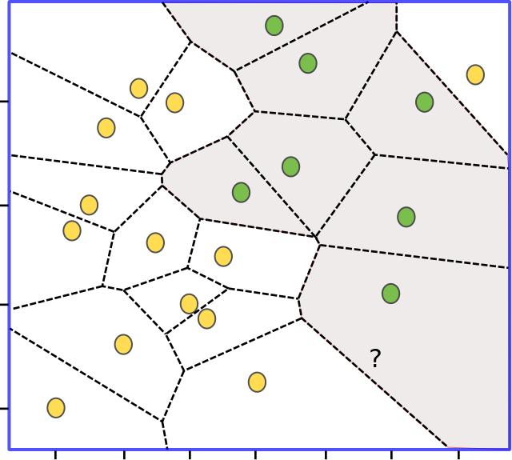
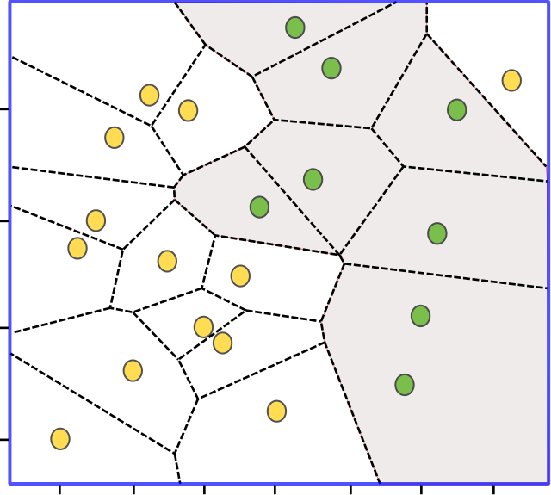
^{K-NEAREST NEIGHBORS (Cont.)}
Finding the nearest neighbor (K = 1).
However, sensitive to noise in the data.
Feature space is partitioned into a Voronoi tesselation: local partitions.
A global prediction boundary is determined by aggregating the local partitions within the feature space.
Source: Fundamentals of Machine Learning for Predictive Data Analytics, Cap. 5

Slide 5
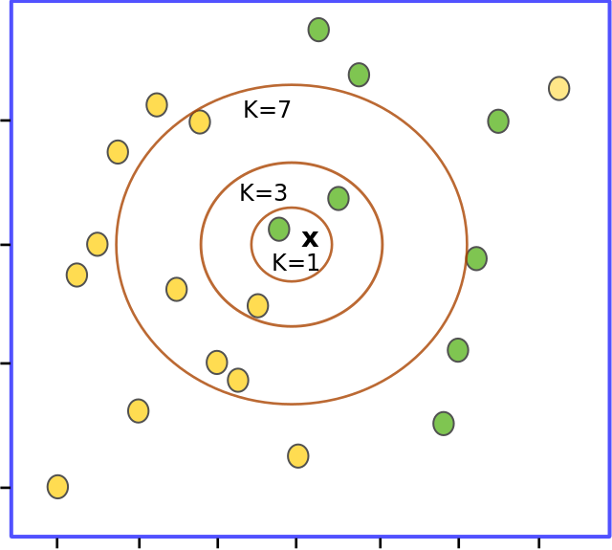
^{K-NEAREST NEIGHBORS (Cont.)}
Decrease the dependency on individual instances (K > 1).
Majority vote in the set of K nearest neighbors.

Slide 6
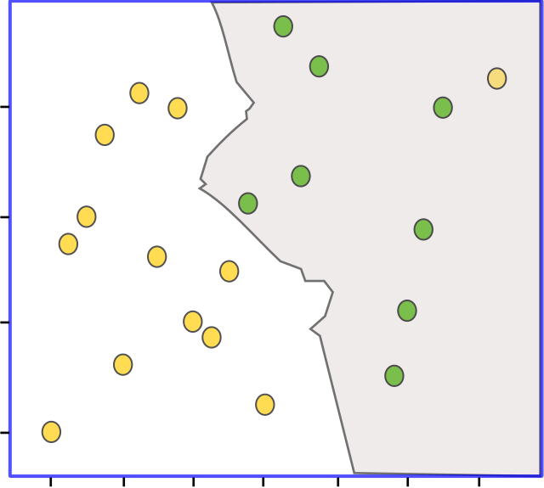
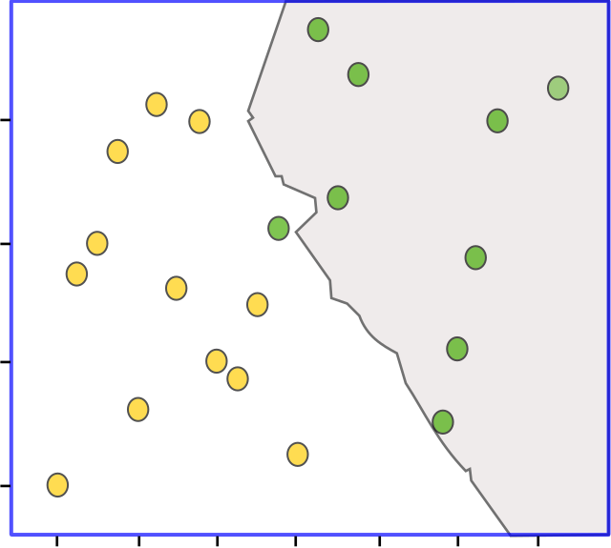
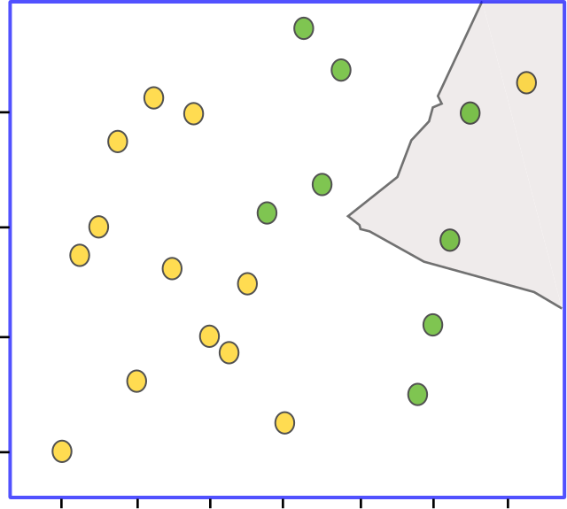
^{K-NEAREST NEIGHBORS (Cont.)}
K = 3
K = 5
K = 15
High values of K -> tendency towards the majority class, therefore
do not work well for imbalanced datasets.
Source: Fundamentals of Machine Learning for Predictive Data Analytics, Cap. 5

Slide 7
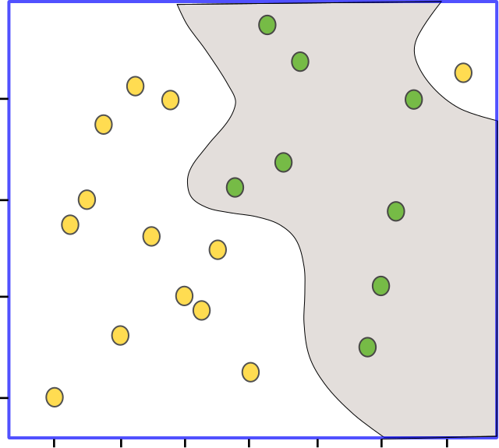
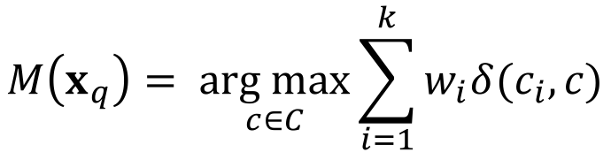
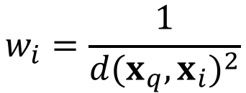
^{K-NEAREST NEIGHBORS (Cont.)}
Distance weighted K-NN
Weight the contribution of each neighbor w.r.t. the distance
between the query and the neighbor:
Close neighbors -> higher weights (more relevance)
Distant neighbors -> less relevance.
K = 21
$$M\left(x_{q}\right)= \underset{c∈C}{arg max}{\sum_{i=1}^{k}{w_{i}δ(c_{i},c)}}$$
$$w_{i}=\frac{1}{{d(x_{q},x_{i})}^{2}}$$
Source: Fundamentals of Machine Learning for Predictive Data Analytics, Cap. 5

Slide 8
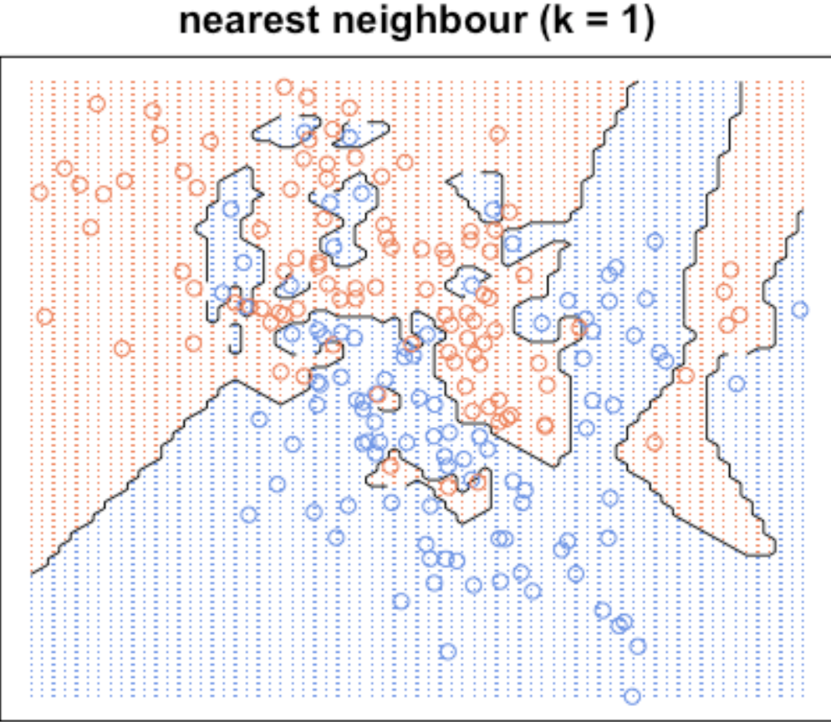
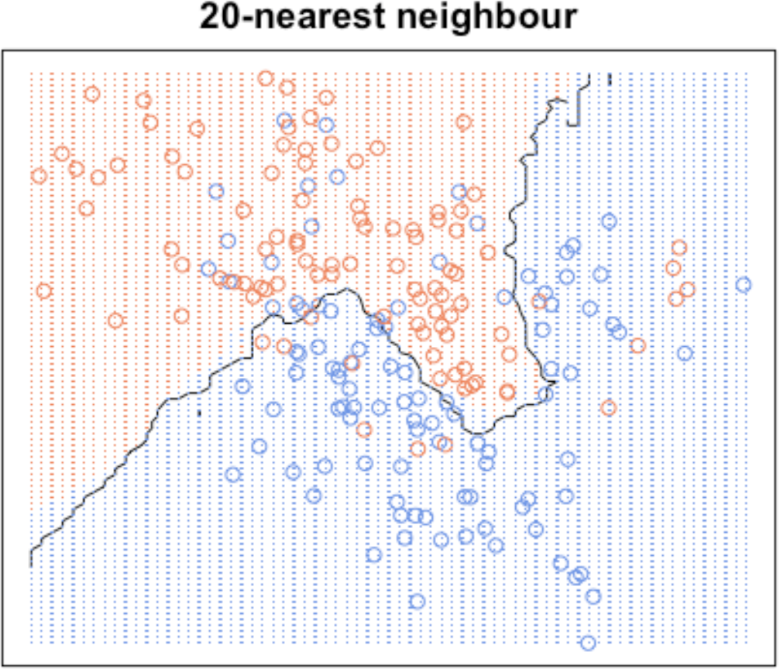
^{ASPECTS OF K-NN}
Pros:
Simple and intuitive.
Can be used for semi-labelled data.
Ease to extend to multiclass classification.
Cons:
Memory-intensive.
Expensive testing or prediction.
Tradeoff: Small values of K -> lower bias
Higher values of K -> lower variance.
Require a meaningful distance metric.
Sensitive to skewed datasets.
Course of dimensionality -> usually dimensionality reduction techniques help.
Source: https://kevinzakka.github.io/2016/07/13/k-nearest-neighbor/
Notes:
CORE Skills first program is the Data Science pilot
Rapid delivery – entrepreneurial business delivery model - Developed by entrepreneurs in collaboration with subject matter experts
top priority given the urgency of this growing gap in the pipeline - skills shortage must not become a crisis
develop the critical skills needed in the context of disruption and opportunity from new digital technologies
We’ve created a vision for a unique social learning environment that is extremely collaborative
We will have real and challenging data-related projects “train hard, fight easy”

Slide 9
^{ASPECTS OF K-NN (Cont.)}
No assumptions about structure of the data.
Retrieval of similar items – but no learning/knowledge.
Works well for large number of data samples – density at the feature space in any point is fairly high.
Can be used for semi-labelled data – samples together should share same labels.
Sufficient domain knowledge should be available – this helps to define a meaningful distance metric.
Noise and outliers may have negative effect.
Attribute normalization is important -> the larger the scale the larger the influence of the attribute.
Notes:
.. therefore we are (1) intensive skills pilot programs to bring new opportunities to market supporting individuals and organisations – and (2) a community of practice
Proactive stance – have impact or be impacted
Industry is supporting us – share knowledge, data, case studies – they recognise the imperative
Can’t predict the future but can be prepared
Profound advances - disrupting old ways of working and enabling step changes in productivity. Jobs, including knowledge work, are being replaced by automation at scale, and those remaining require increased human–machine interaction.
Data generation continues to grow exponentially, as every piece of equipment connects. This explosion of data—combined with analytics and machine learning—creates opportunities
means great improvements in workforce productivity. E.g. advanced analytics -sift through 1000s of capital projects - isolate a few simple measures that improved engineering productivity >20%.

Slide 10

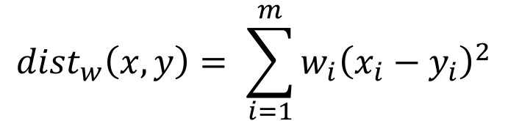
^{ASPECTS OF K-NN (Cont.)}
What about feature importance?
Irrelevant features increase costs without affecting accuracy.
Misleading features increase costs and decrease accuracy.
Attribute-weighted K-NN
$${dist}_{w}\left(x,y\right)= \sum_{i=1}^{m}{{w_{i}\left(x_{i}−y_{i}\right)}^{2}}$$
How to find the weights?
You have an expert to advice you.
Or, rely on ML!
Optimized data structures and implementations:
Approximate Nearest Neighbor (k-d trees).
Locality sensitive hashing (LSH) – for higher dimensions.
Notes:
.. therefore we are (1) intensive skills pilot programs to bring new opportunities to market supporting individuals and organisations – and (2) a community of practice
Proactive stance – have impact or be impacted
Industry is supporting us – share knowledge, data, case studies – they recognise the imperative
Can’t predict the future but can be prepared
Profound advances - disrupting old ways of working and enabling step changes in productivity. Jobs, including knowledge work, are being replaced by automation at scale, and those remaining require increased human–machine interaction.
Data generation continues to grow exponentially, as every piece of equipment connects. This explosion of data—combined with analytics and machine learning—creates opportunities
means great improvements in workforce productivity. E.g. advanced analytics -sift through 1000s of capital projects - isolate a few simple measures that improved engineering productivity >20%.

Slide 11

^{DECISION TREES}
Used for:
Classification and regression.
Information-based learning:
Informativeness of a descriptive feature: split the dataset into branches that maximize the information gain, reducing the node’s impurity.
Sources: Fundamentals of Machine Learning for Predictive Data Analytics, Cap. 4; Hands on Machine Learning with Scikit-Learn and TensorFlow, Cap. 6.

Slide 12
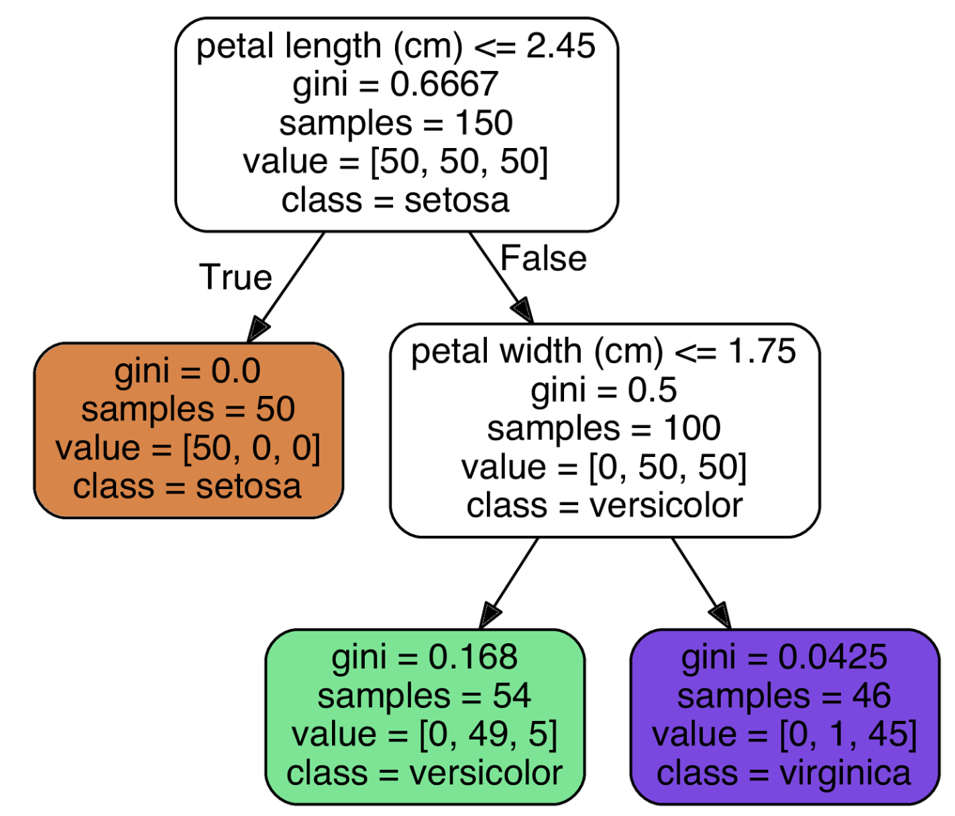
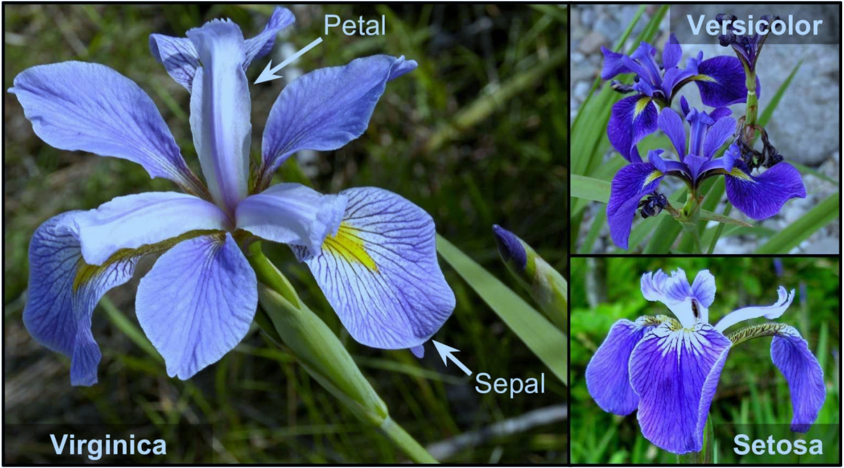
^{DECISION TREES (Cont.)}
Sources: Fundamentals of Machine Learning for Predictive Data Analytics, Cap. 4; Hands on Machine Learning with Scikit-Learn and TensorFlow, Cap. 6.

Slide 13
^{ASPECTS OF DECISION TREES}
Pros:
Works well for complex datasets.
Require very little data preparation (even scaling is not necessary).
Example of a white box approach: decisions are intuitive.
Cons:
Rely on a good tunning of restrictions (hyperparameters) to avoid overfitting – otherwise trees can just memorize the training data.
Sensitive to training set rotation. You can use PCA to get a better orientation of the training data.
Sensitive to small variations in the training set.
Notes:
CORE Skills first program is the Data Science pilot
Rapid delivery – entrepreneurial business delivery model - Developed by entrepreneurs in collaboration with subject matter experts
top priority given the urgency of this growing gap in the pipeline - skills shortage must not become a crisis
develop the critical skills needed in the context of disruption and opportunity from new digital technologies
We’ve created a vision for a unique social learning environment that is extremely collaborative
We will have real and challenging data-related projects “train hard, fight easy”

Slide 14
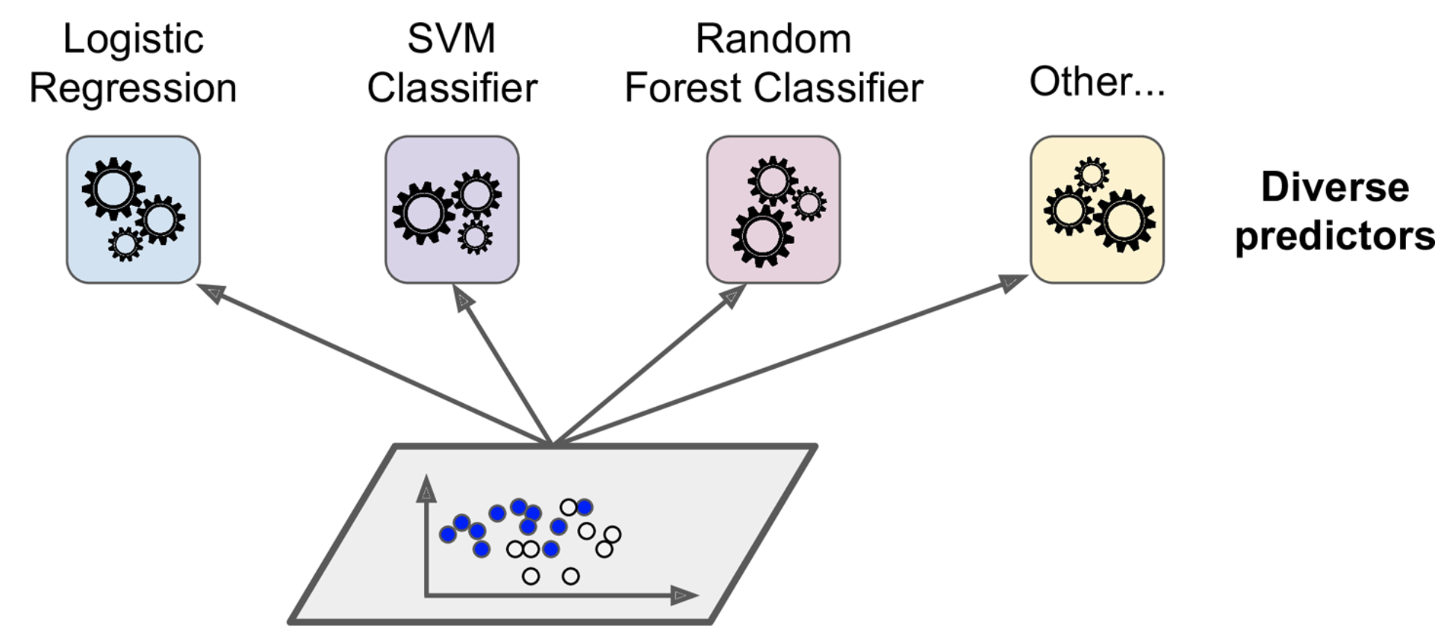
^{ENSENBLE LEARNING}
Idea: Combine the predictions of many predictors to get a better final prediction.
1
Ensemble’s prediction
(e.g., majority vote)
1
2
1
1
Training set
Source: Hands on Machine Learning with Scikit-Learn and TensorFlow, Cap. 7.

Slide 15
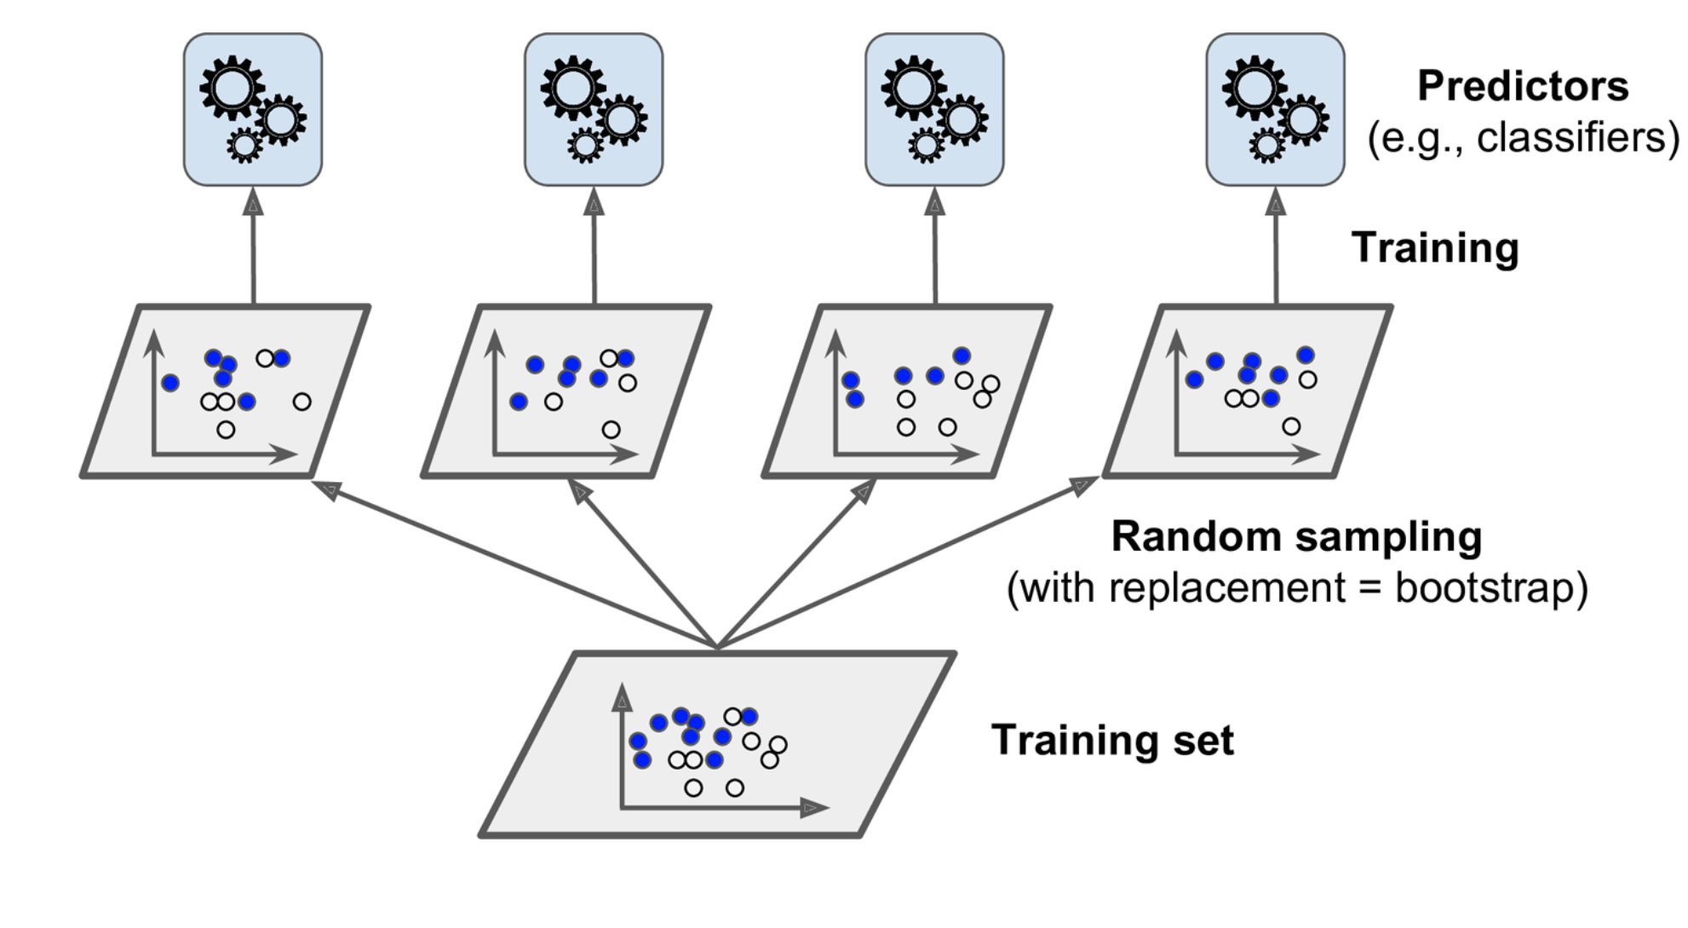
^{ENSENBLE LEARNING (Cont.)}
Bagging (Bootstrap aggregating) and pasting.
Train the models on different random subsets of the training set.
Individual predictors have high bias, but in overall aggregation produces similar bias and lower variance when compared to training one predictor.
Source: Hands on Machine Learning with Scikit-Learn and TensorFlow, Cap. 7.

Slide 16
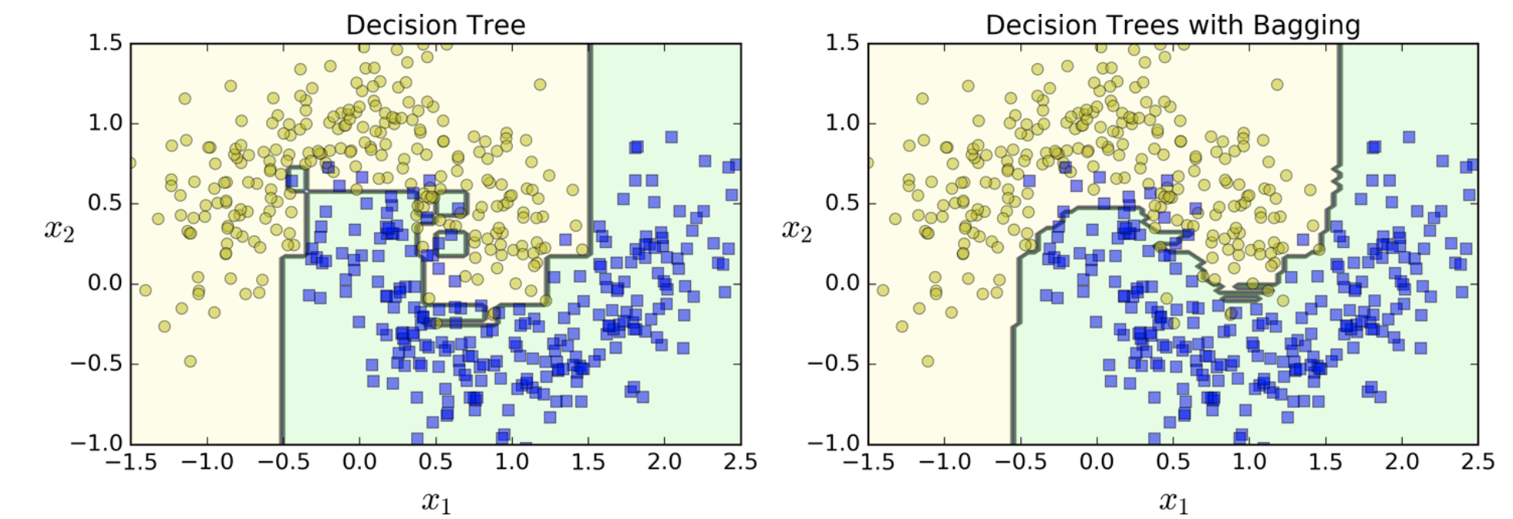
^{ENSENBLE LEARNING (Cont.)}
The ensemble’s prediction tends to generalize better than a single predictor.
Bagging or pasting?
Bagging introduces more diversity: slightly higher bias but lower variance.
Bagging tends to produce better results.
Other approaches: Boosting (AdaBoost, Gradient Boosting), Stacking.
Source: Hands on Machine Learning with Scikit-Learn and TensorFlow, Cap. 7.

Slide 17
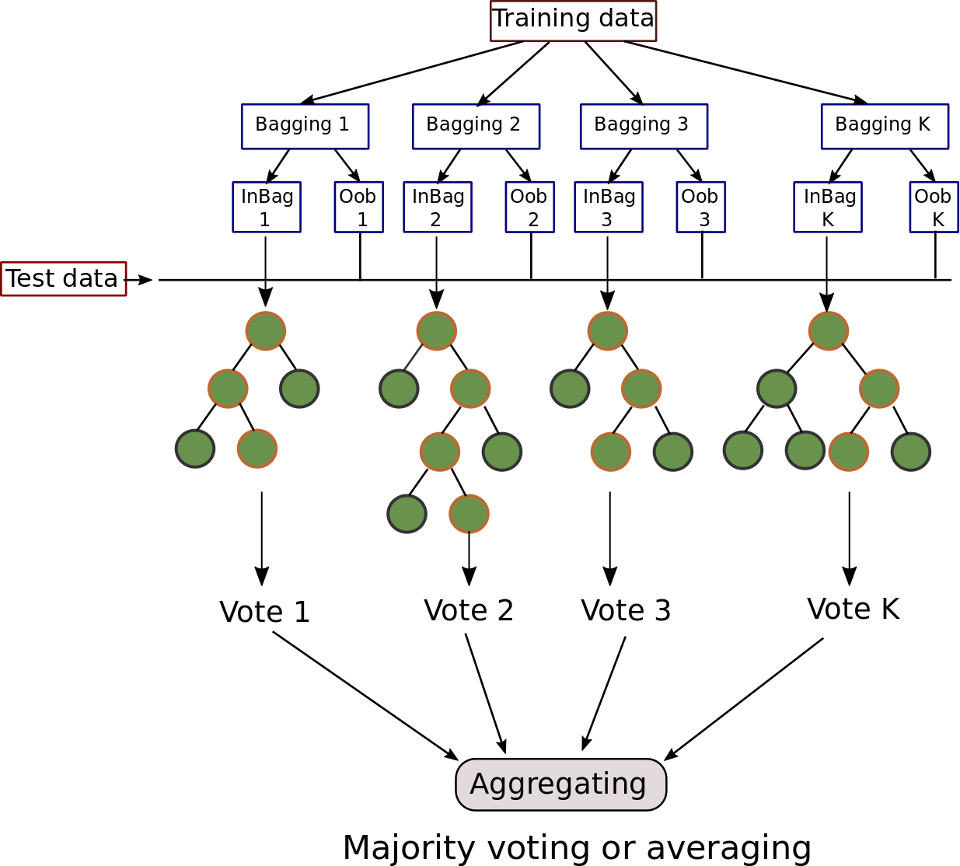
^{RANDOM FOREST}
An ensemble of Decision Trees:
Most commonly trained with the bagging method.
Searches for the most informative feature
in a (random) subset of the training set.
Tree diversity favours higher bias
for a lower variance.
Feature importance
Most important features are
likely to be near the root.
Average depth at which a specific
feature appears across all trees.
Feature_importance_variable.
Source: Hands on Machine Learning with Scikit-Learn and TensorFlow, Cap. 7.

Slide 18
^{ASPECTS OF RANDOM FOREST}
Pros:
Among the most powerful ML algorithms.
Learn nonlinearities in the training set structure.
Robust to outliers.
Cons:
In each node, the training algorithm compares all features in all samples. It can be slow for larger datasets.
Attention to the regularization hyperparameters.
Ensemble makes prediction less intuitive.
Notes:
CORE Skills first program is the Data Science pilot
Rapid delivery – entrepreneurial business delivery model - Developed by entrepreneurs in collaboration with subject matter experts
top priority given the urgency of this growing gap in the pipeline - skills shortage must not become a crisis
develop the critical skills needed in the context of disruption and opportunity from new digital technologies
We’ve created a vision for a unique social learning environment that is extremely collaborative
We will have real and challenging data-related projects “train hard, fight easy”

Slide 19

ASPECTS OF RANDOM FOREST (Cont.)
Promise technique when there are many discontinuities in the data structure (orthogonal features) – features showing almost no linear dependencies.
Identification of geological rocktypes
Source: Harvey, A. S., and G. Fotopoulos. "GEOLOGICAL MAPPING USING MACHINE LEARNING ALGORITHMS." International Archives of the Photogrammetry, Remote Sensing & Spatial Information Sciences 41 (2016).
Notes:
.. therefore we are (1) intensive skills pilot programs to bring new opportunities to market supporting individuals and organisations – and (2) a community of practice
Proactive stance – have impact or be impacted
Industry is supporting us – share knowledge, data, case studies – they recognise the imperative
Can’t predict the future but can be prepared
Profound advances - disrupting old ways of working and enabling step changes in productivity. Jobs, including knowledge work, are being replaced by automation at scale, and those remaining require increased human–machine interaction.
Data generation continues to grow exponentially, as every piece of equipment connects. This explosion of data—combined with analytics and machine learning—creates opportunities
means great improvements in workforce productivity. E.g. advanced analytics -sift through 1000s of capital projects - isolate a few simple measures that improved engineering productivity >20%.

Slide 20
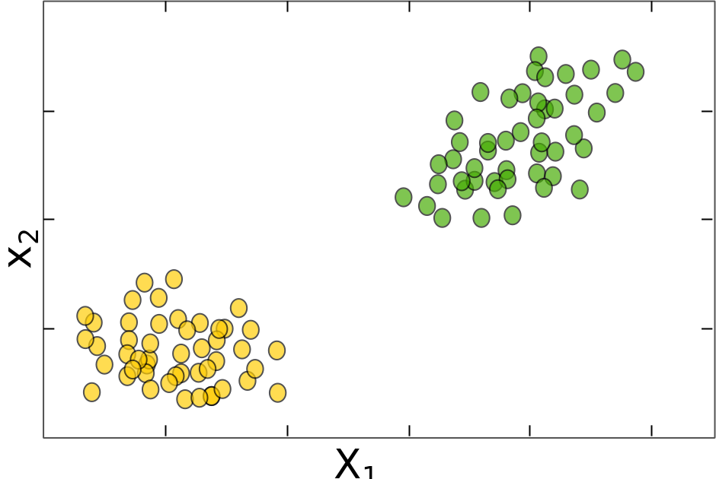
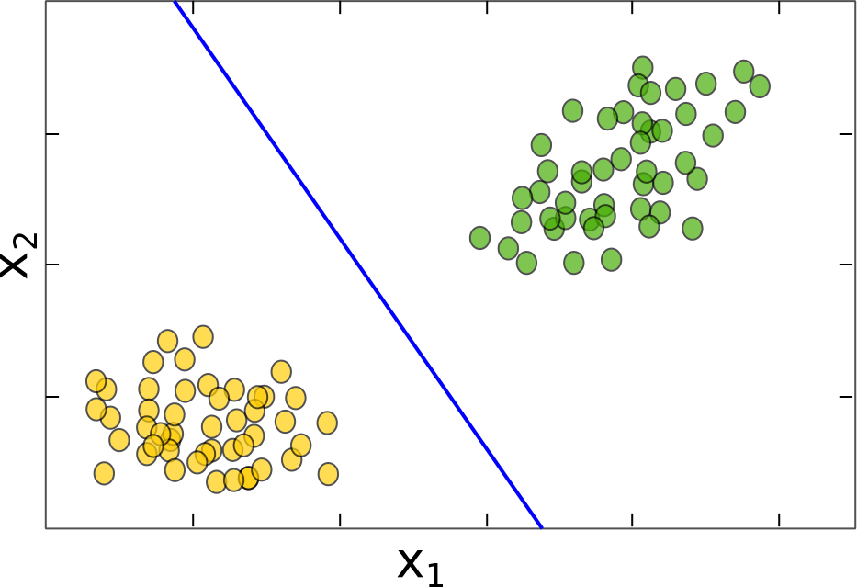
^{SUPPORT VECTOR MACHINES (SVM)}
Used for:
Classification and regression.
Large margin classification:
It maximizes the distance to the nearest points relative to both classes.
What that means?
More robust to classification errors, better generalization.
support
vectors

Slide 21
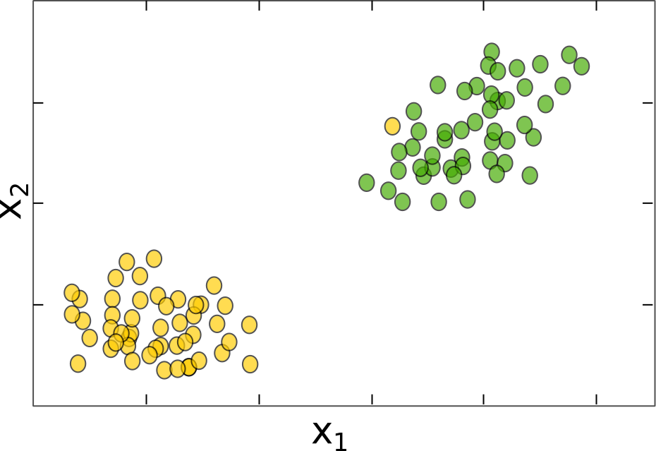
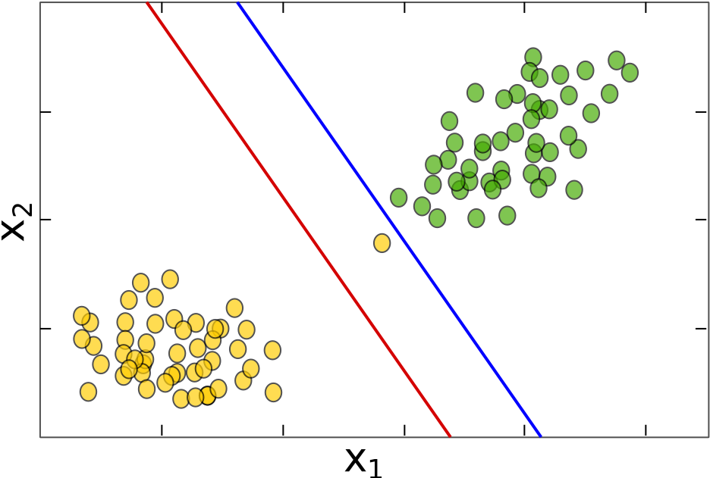
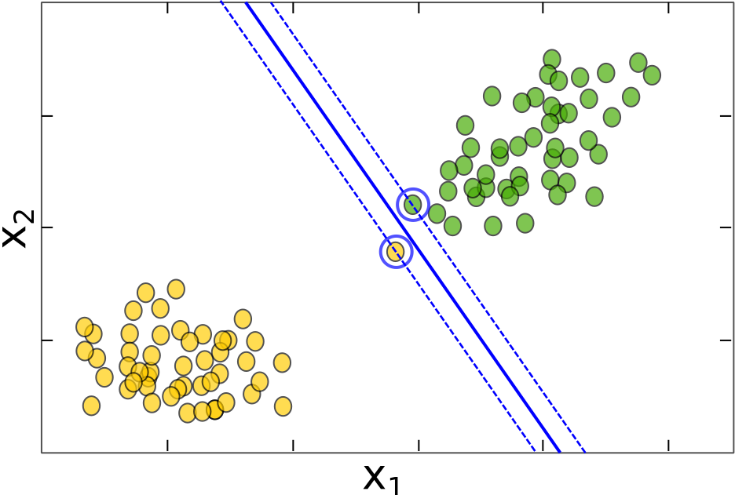
SUPPORT VECTOR MACHINES (Cont.)
Hard margin classification:
Imposes all samples are correctly classified.
Sensitive to outliers.
Requires a linear separable solution.
What would be the correct SVM output?
First the correct classification, then maximize the margin.

Slide 22
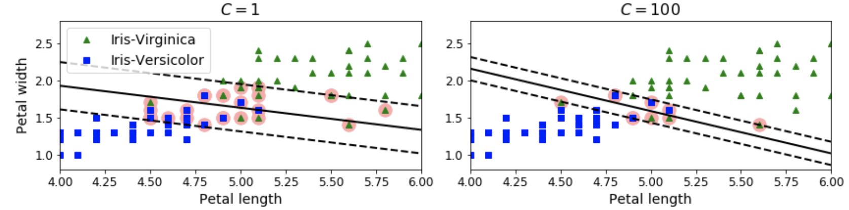
SUPPORT VECTOR MACHINES (Cont.)
Soft margin classification
More flexible model.
Balance between maximizing the margin and
allowing some misclassifications.
SVM are robust to outliers by mediating well this compromise.
How SVM control this balance?
Hyperparameter C can play a role if the model is overfitting: the larger the value of C the more intricate or restricted the decision boundary is.
Source: Hands on Machine Learning with Scikit-Learn and TensorFlow, Cap. 5.

Slide 23
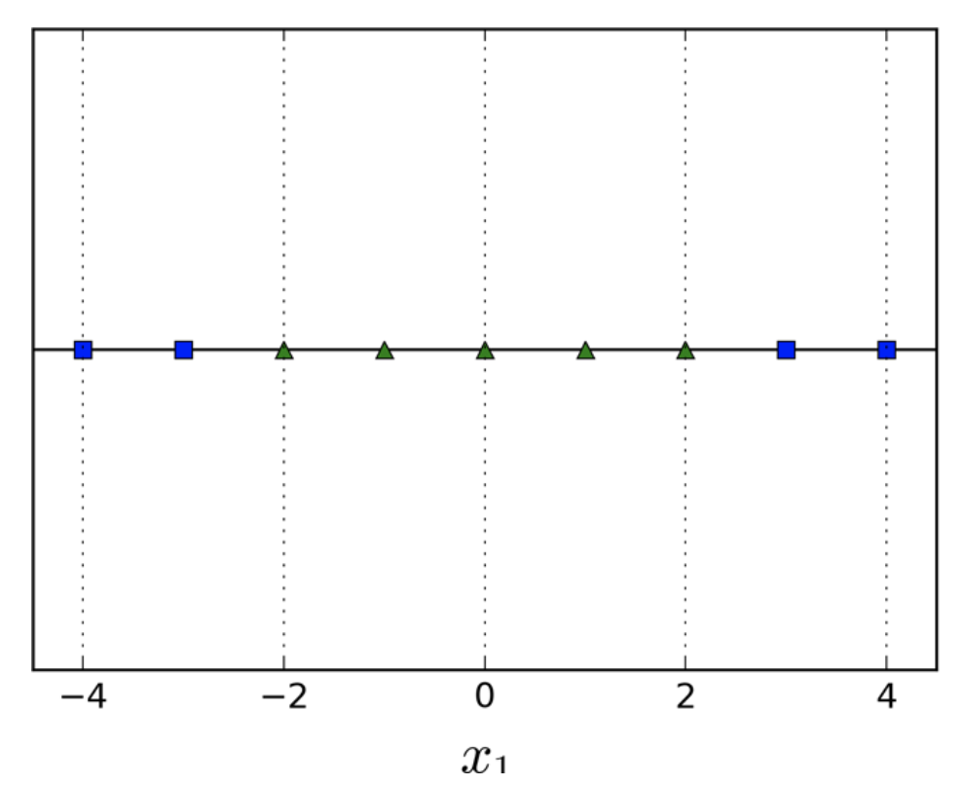
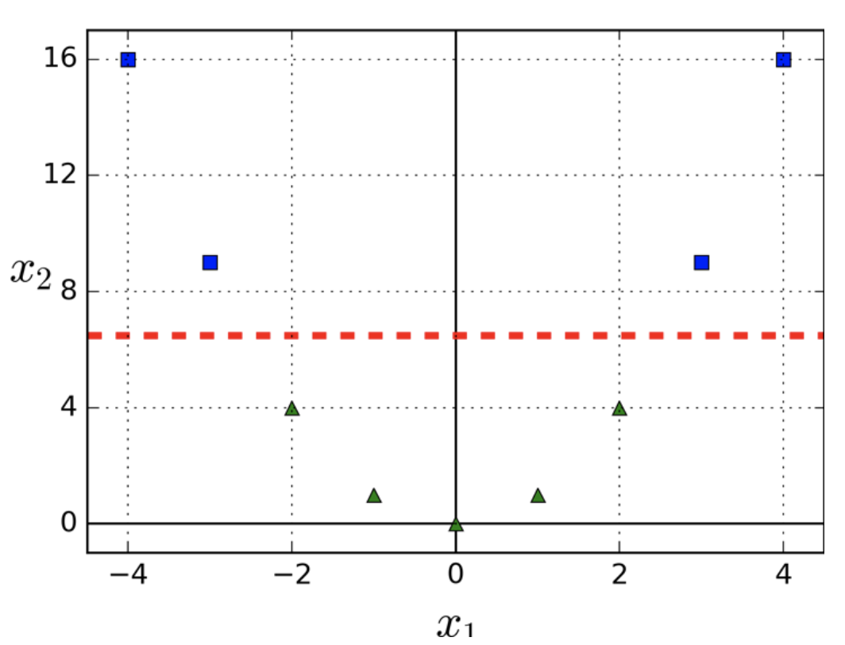
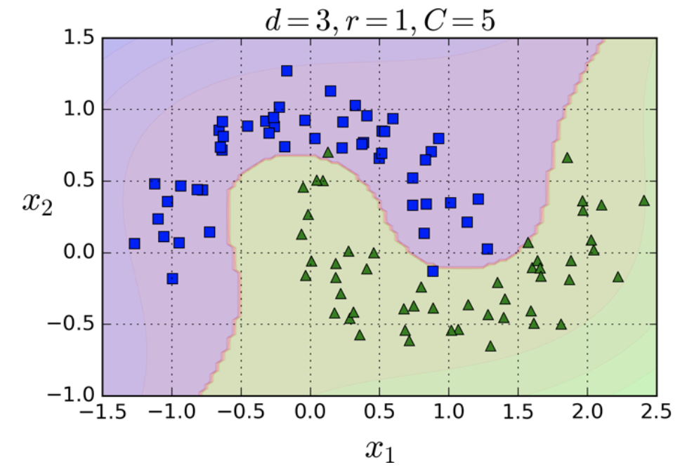
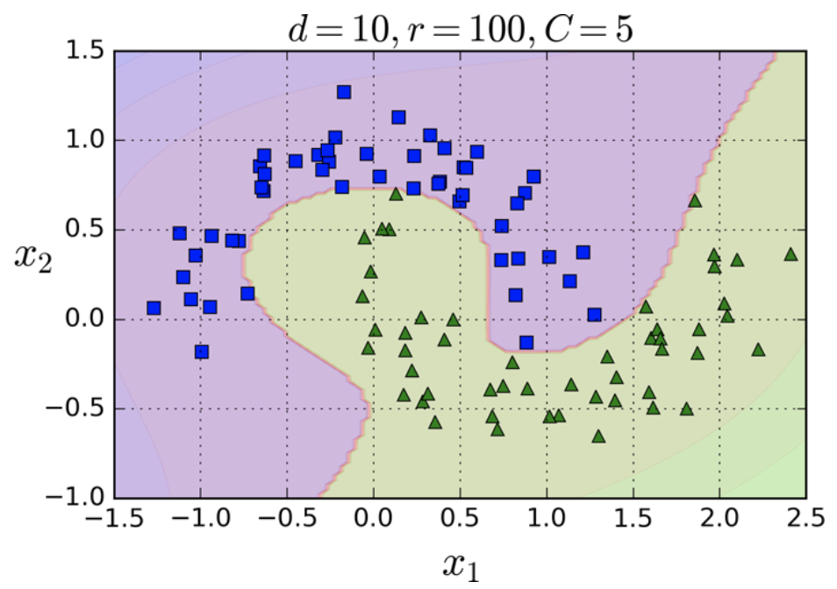
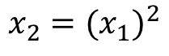
SUPPORT VECTOR MACHINES (Cont.)
Nonlinear classification?
$$x_{2}={(x_{1})}^{2}$$
Polynomial features
Kernel trick!
Polynomial kernel
Source: Hands on Machine Learning with Scikit-Learn and TensorFlow, Cap. 5.

Slide 24
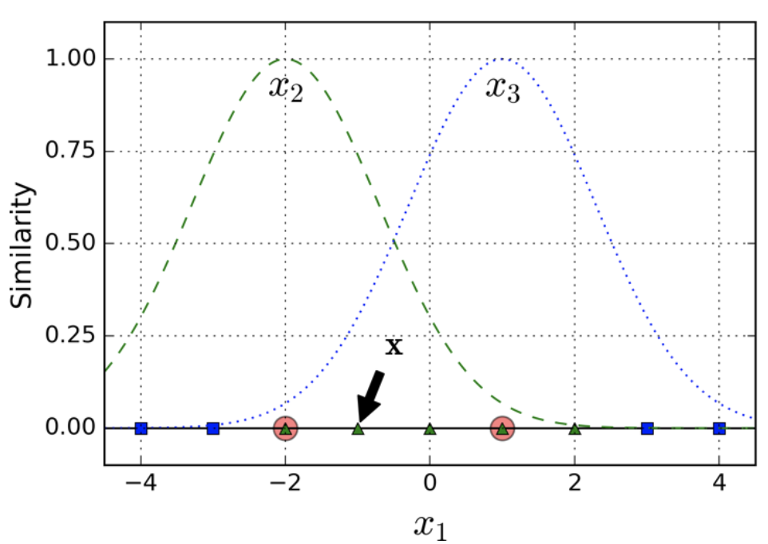
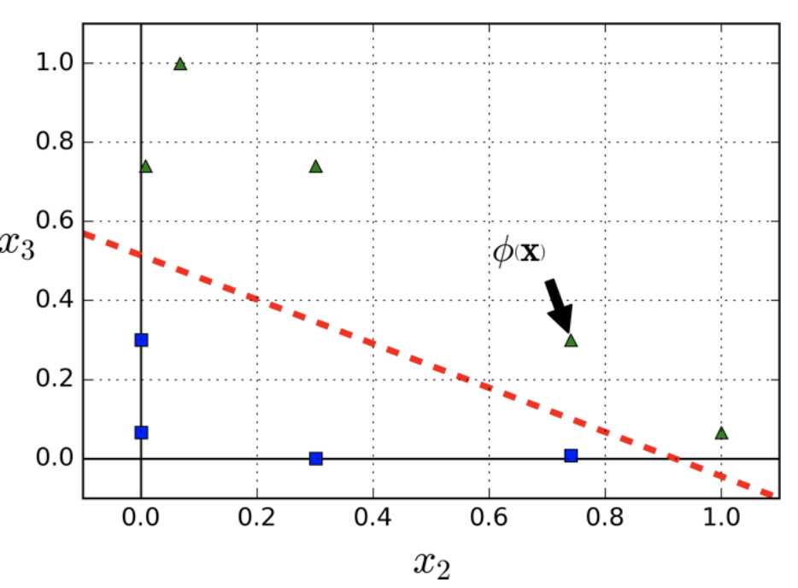
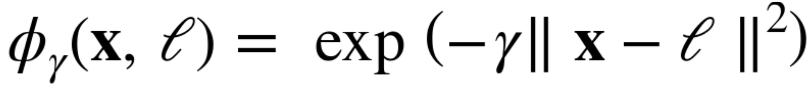
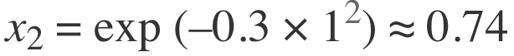
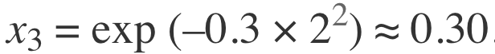
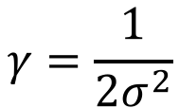
SUPPORT VECTOR MACHINES (Cont.)
Similarity features
Similarity function: Gaussian Radial Basis Function (RBF) with $γ$ = 0.3
Hyperparameter 𝛄
Define how far the influence of a single training example reaches.
Low values led to smoother boundaries.
$$γ=\frac{1}{2σ^{2}}$$
Source: Hands on Machine Learning with Scikit-Learn and TensorFlow, Cap. 5.

Slide 25
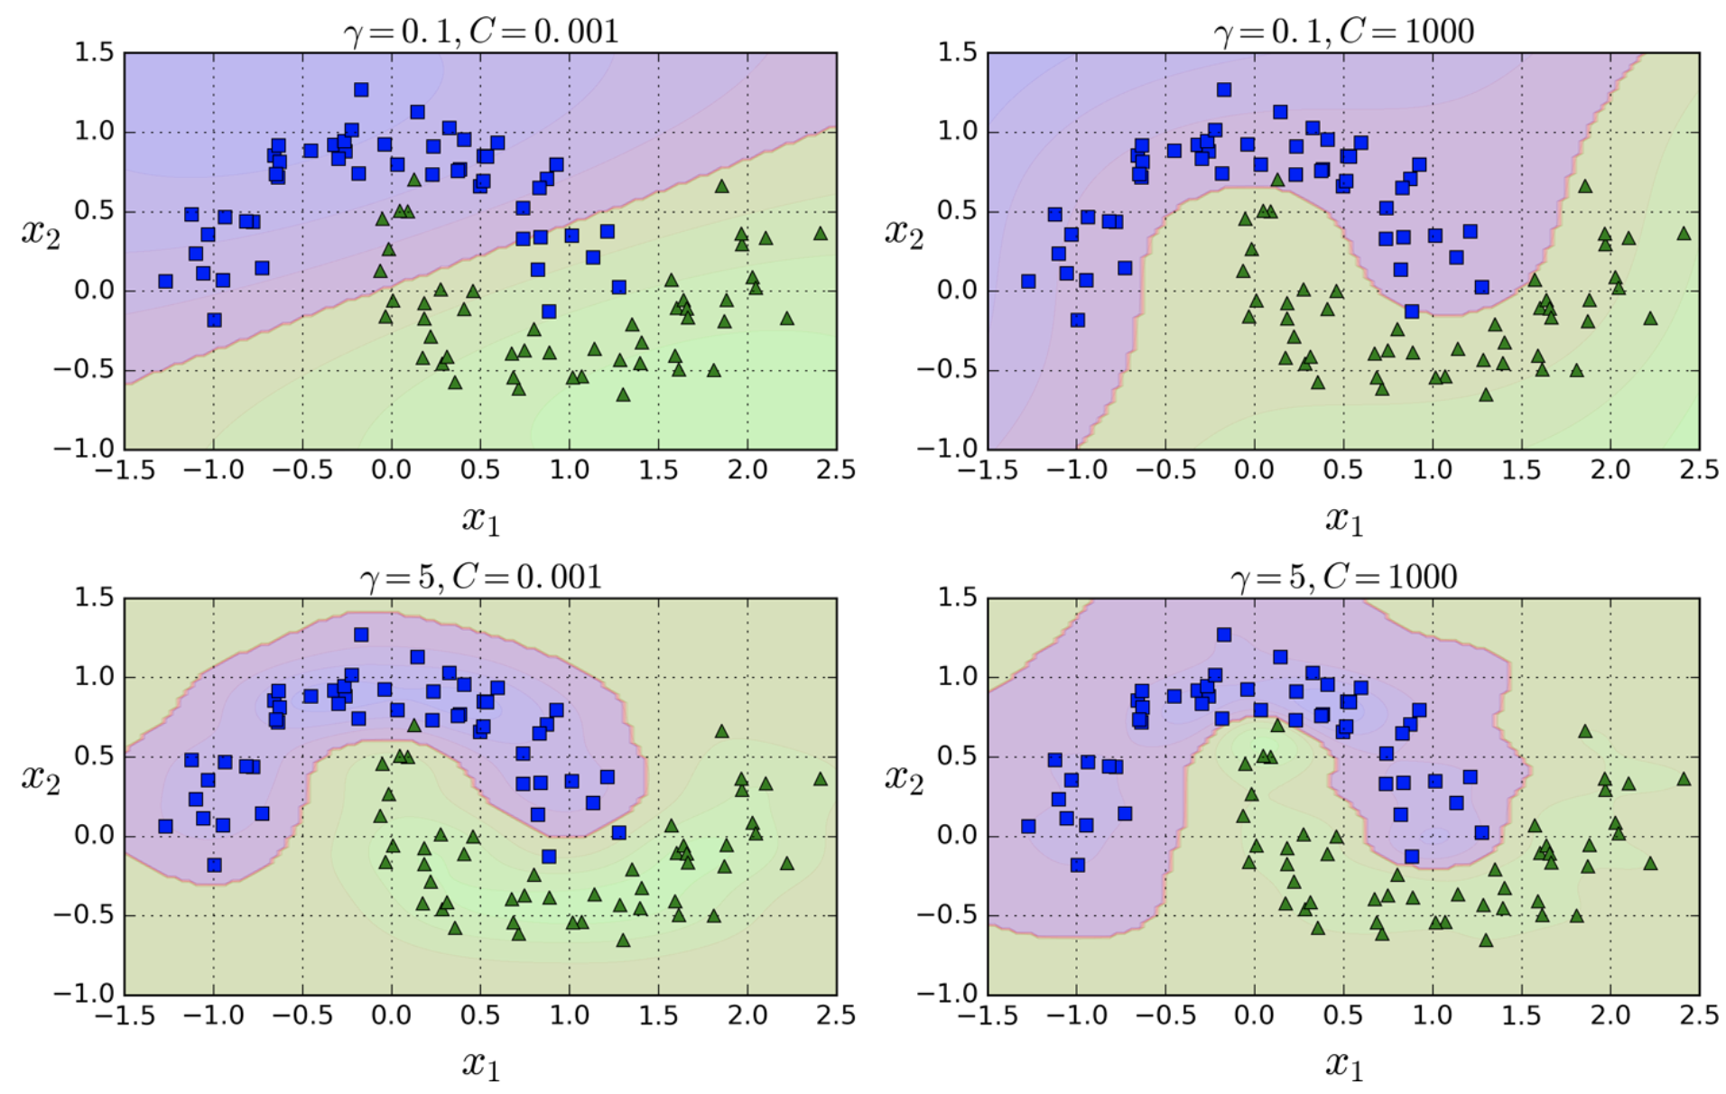
SUPPORT VECTOR MACHINES (Cont.)
Gaussian RBF Kernel
Source: Hands on Machine Learning with Scikit-Learn and TensorFlow, Cap. 5.

Slide 26
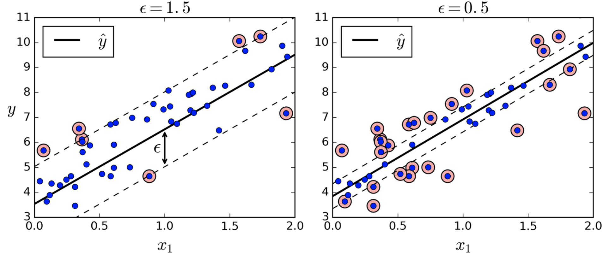
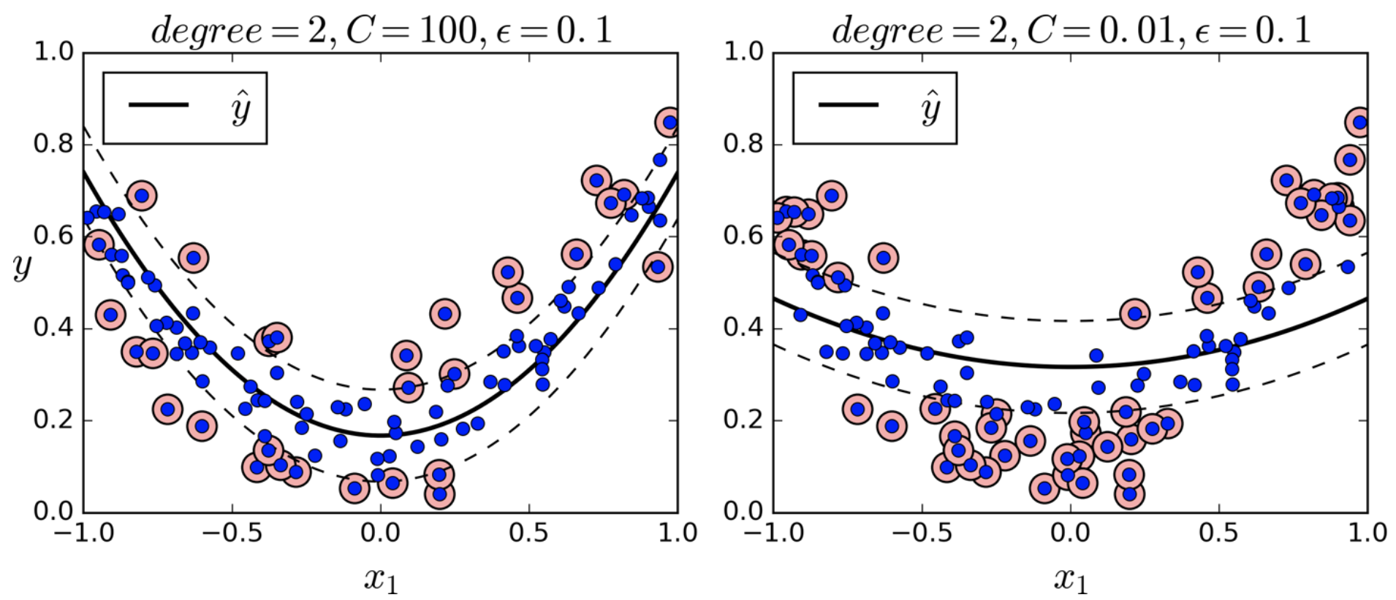
SUPPORT VECTOR MACHINES (Cont.)
Regression.
Reverse the objective - fit data samples within the margin.
Source: Hands on Machine Learning with Scikit-Learn and TensorFlow, Cap. 5.

Slide 27
^{ASPECTS OF SVM}
Pros:
Works well for complex small to medium-size datasets.
Works well in high-dimensional feature spaces.
Works reasonable well where number of dimensions is greater than number of data instances.
Estimation of the decision boundary is conducted on a subset of points – the support vectors.
Kernel trick allows the specification of complex decision functions.
Generally works well on sparse data.
Notes:
CORE Skills first program is the Data Science pilot
Rapid delivery – entrepreneurial business delivery model - Developed by entrepreneurs in collaboration with subject matter experts
top priority given the urgency of this growing gap in the pipeline - skills shortage must not become a crisis
develop the critical skills needed in the context of disruption and opportunity from new digital technologies
We’ve created a vision for a unique social learning environment that is extremely collaborative
We will have real and challenging data-related projects “train hard, fight easy”

Slide 28
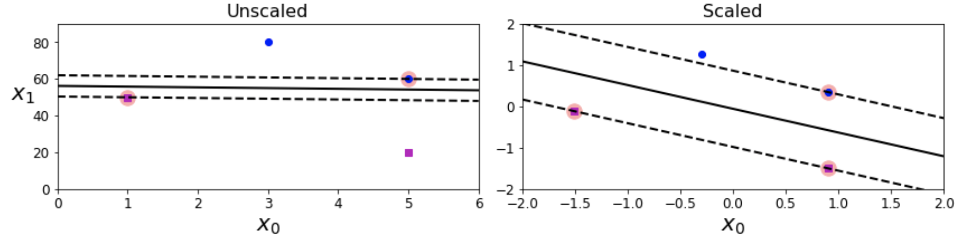
^{ASPECTS OF SVM (Cont.)}
Cons:
Interpretability.
Sensitiveness to feature scales.
Slow for hundreds of thousands of instances.
Regularization is essential when the number of instances is much lower then the number of features.
Rely on the concept of distance – it has to be meaningful.
Trickier to tune. Rule of thumb: try first linear, then Gaussian RBF and then polynomial kernels.
Notes:
CORE Skills first program is the Data Science pilot
Rapid delivery – entrepreneurial business delivery model - Developed by entrepreneurs in collaboration with subject matter experts
top priority given the urgency of this growing gap in the pipeline - skills shortage must not become a crisis
develop the critical skills needed in the context of disruption and opportunity from new digital technologies
We’ve created a vision for a unique social learning environment that is extremely collaborative
We will have real and challenging data-related projects “train hard, fight easy”

